Slide 1

Team Nature NaturePass
Derrick Lor, Aiman Baig, Jason Huang, Joseph K J
This Photo by Unknown author is licensed under CC BY-SA.

Slide 2
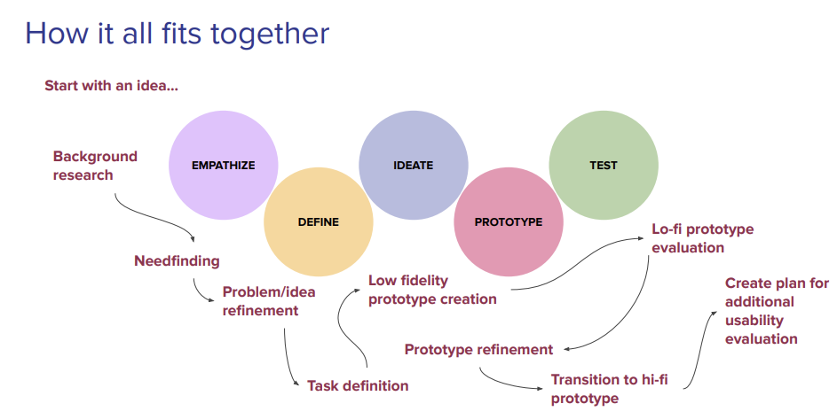
HCI Cycle

Slide 3
Motivation
Implement Personal Experience
A mobile application for information
A platform for users to share their experiences
Explore and plan future trips

Slide 4
Empathize
Summer is approaching
Vacation time
Increased activity
Physical exercise
Outdoor Recreation
Inspiration

Slide 5
Need finding
Context
Nature
Reviews
Images
Audience
Online
Outdoors
Families
Thrill Seekers
Novice
Tourists
Advanced
Adventurers
Stakeholders
In Person
Content creators
Users
Conservation Groups
Local Businesses
Greenery
Fauna
Activities

Slide 6
Need finding
Interviewees wanted...
New and exciting​
Natural beauty​
Traveling​
Easy to use
Palm of hand

Slide 7
Define
Explore
Search
Filter
By Tags
By Ratings
Feed
Scroll
Algorithm
Photos
View
Inspect
Import
Delete
tasks the users can perform
Calendar
View
Add stops
Add Trips
Plan
Customize
UI/UX
Intuitive
Familiar
Simple
Uniform
Modern
Dual Tone

Slide 8
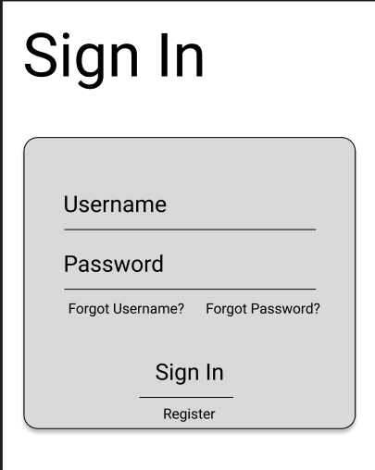
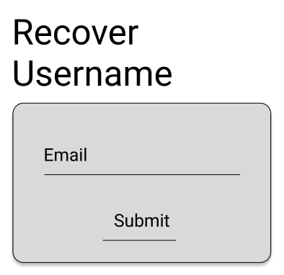

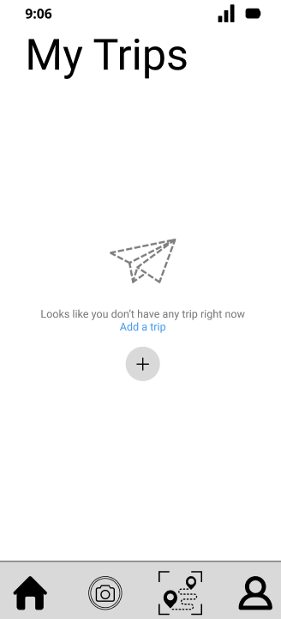
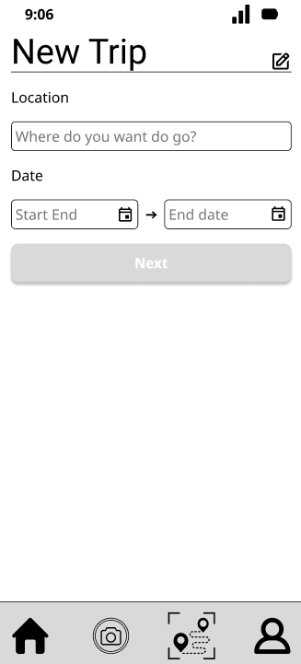
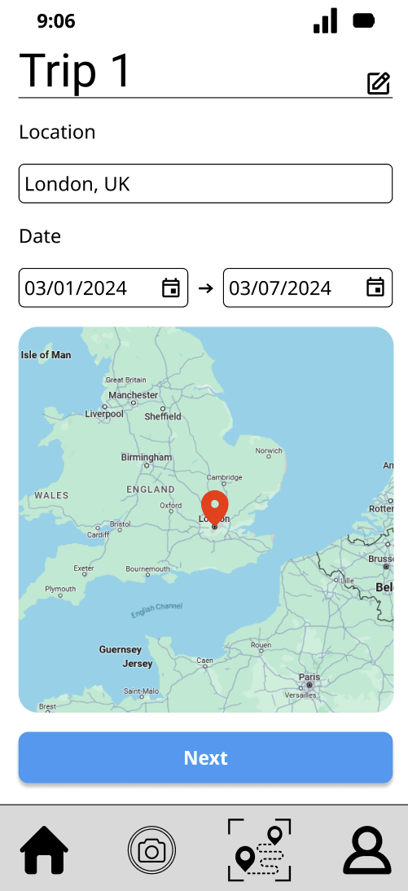
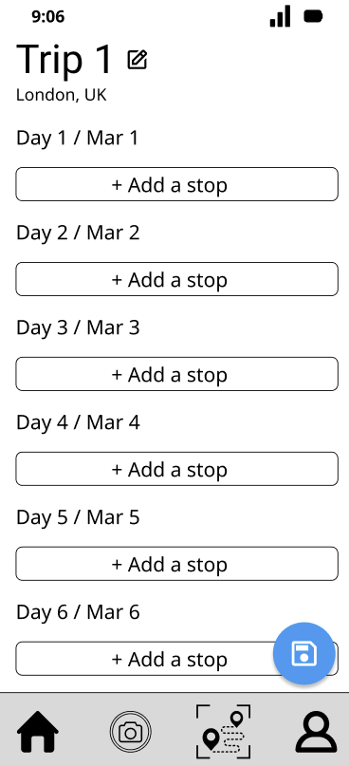
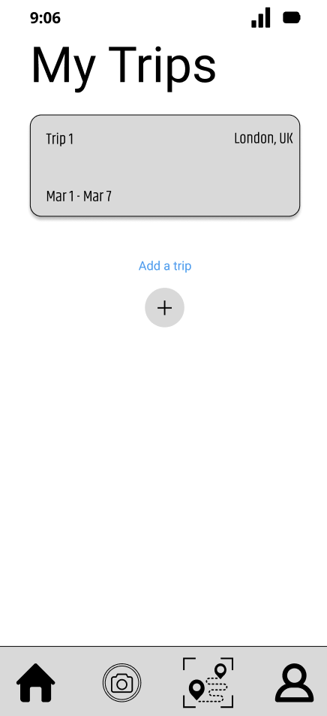
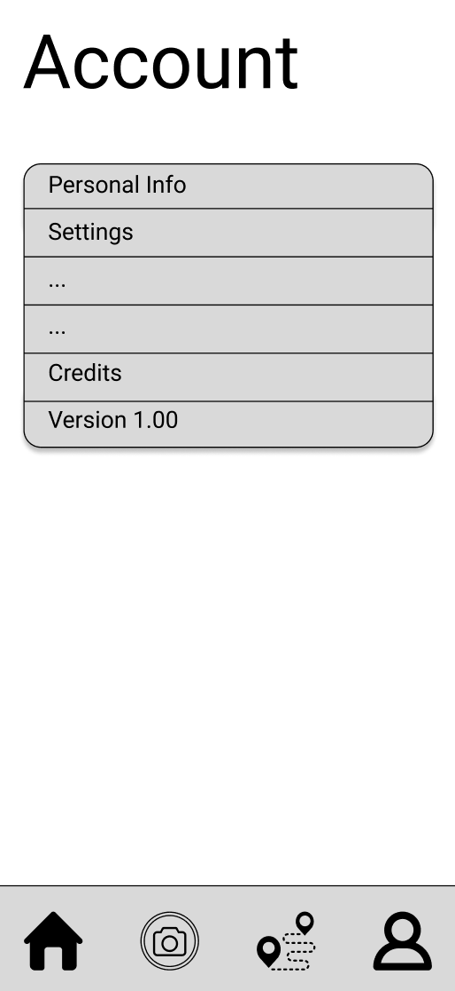
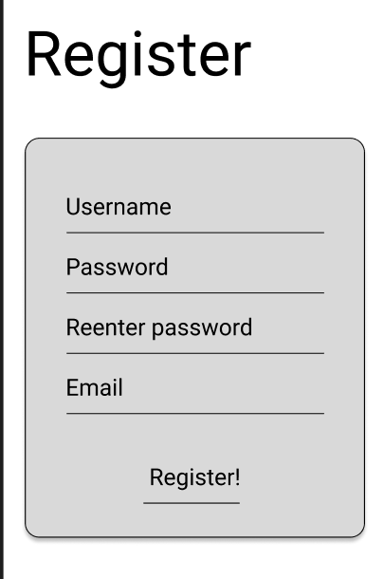
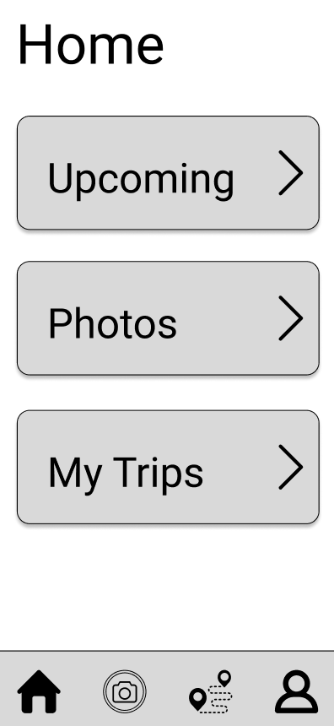
Ideate & Prototype

Slide 9
Feedback
Classmates
participants
Shrink and make clean
Consolidate and streamline
Ability to personalize
Include more interactable elements
Add navigation signifiers
Visual feedback
Able to filter searches
Look at reviews

Slide 10
showcase the final prototype

Slide 11
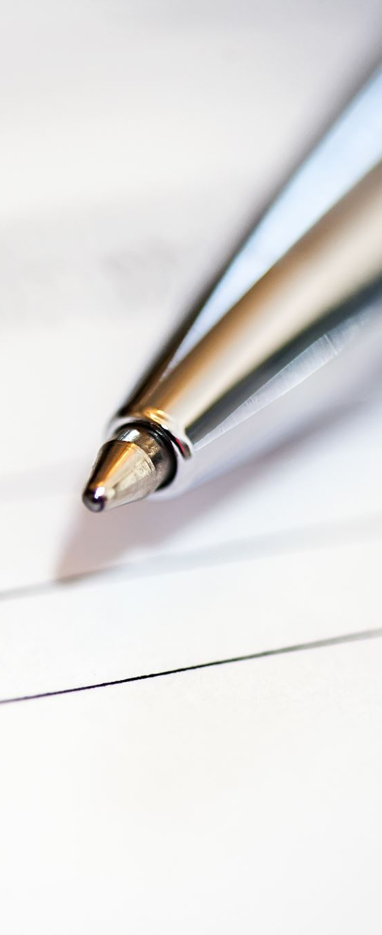
10 Heuristic Evaluations
1: Visibility of System Status
2: Match Between the System and the Real World
3: User Control and Freedom
4: Consistency and Standards
5: Error Prevention
6: Recognition Rather than Recall
7: Flexibility and Efficiency of Use
8: Aesthetic and Minimalist Design
9: Help Users Recognize, Diagnose, and Recover from Errors
10: Help and Documentation

Slide 12
Important takeaways
The first two phases are the easiest
The last three phases are the hardest
Define
Empathize
Prototype
Test
Ideate

Slide 13
Future Outlook
Mobile friendly
Fingerprint sign in
Facial recognition sign in
Notifications
Backend
Database retrieval
Security Encryption
Integration
Secure Sign-On
Sync to Cloud
Portability
Desktop version
IOS
Android
Algorithm
Personalize feed based on user data
Disability Features
Colorblind Mode
Sound Transcript

Slide 14

Thank you
Questions?

